Slide 1
Machine Learning based Analysis of Antibiogram
(UTI CDSS)
Internship Report
Name of the Student :JOEL GEORGE
Industry Mentors : DR.SRIJA KATTA , ABHISHEK CHOUDHARY
Duration of Internship :
Team : Joel george,chrins Thomas Jojo,Antriya Tom

Slide 2
INTRODUCTION
We chose it because we need to expose that technology can bring tremendous changes in the health care field instead of sticking to the bygone system of healthcare. Technology has a significant role in everything as in healthcare also. By applying ML in health care it can carry out to the best benefits such as
1.It can ease up the job role of physicians and health care workers
2.It can contribute to the reduced mortality rate and helps to find out the unknown problem behind the health care
3.it helps drug discovery and management, data collection ,clinical trial etc
We chose this topic as our project because, in the era of increasing antimicrobial resistance, the need for early identification and prompt treatment of multidrug-resistant infections is crucial for achieving favorable outcomes in critically ill patients. As traditional microbiological susceptibility testing requires at least 24 hours, automated machine learning (AutoML) techniques could be used as clinical decision support tools to predict antimicrobial resistance and select appropriate empirical antibiotic treatment. So we go through a lot of literatures regarding applying ml in healthcare and decided to do this as our thesis work

Slide 3
Link for Demo : https://bit.ly/uti-cdss
Repository link : https://github.com/Joelgeorge6/joelgeorge.github.io
Proof of work:

Slide 4
Table of contents
Basics of work environment
Github id and forking
Ayepages portfolio creation
Basics on Notebooks
Pre-processing of Data
Data Clean up
Data Anonymization
Preparation of UTI CDSS on the Notebook
Setting up the environment
Training and Testing the data
Elimination of Skewed Data and Finalisation
Observations and limitations
Skewness in the data
Inadequate data collection
Future perspectives and suggestions
Variables to be considered for Data Collection
Improvements

Slide 5
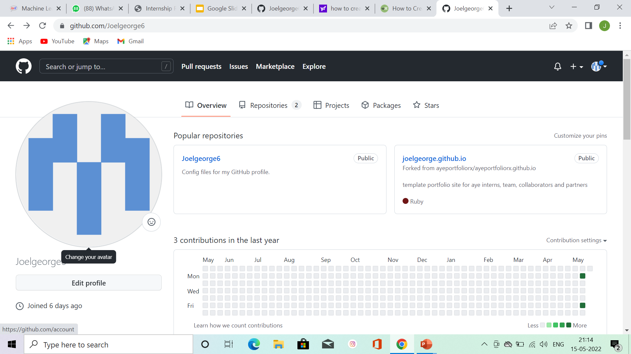
Github Basics
Github ID creation :
1.Go to https://github.com/join in a web browser. You can use any web browser on your computer, phone, or tablet to join.
2.Enter your personal details. In addition to creating a username and entering an email address, you'll also have to create a password
3.Complete the CAPTCHA puzzle.
4 Click the Verify email address button in the message from GitHub.
5Select your preferences and click Submit.
And Paste the screenshots of your Id

Slide 6
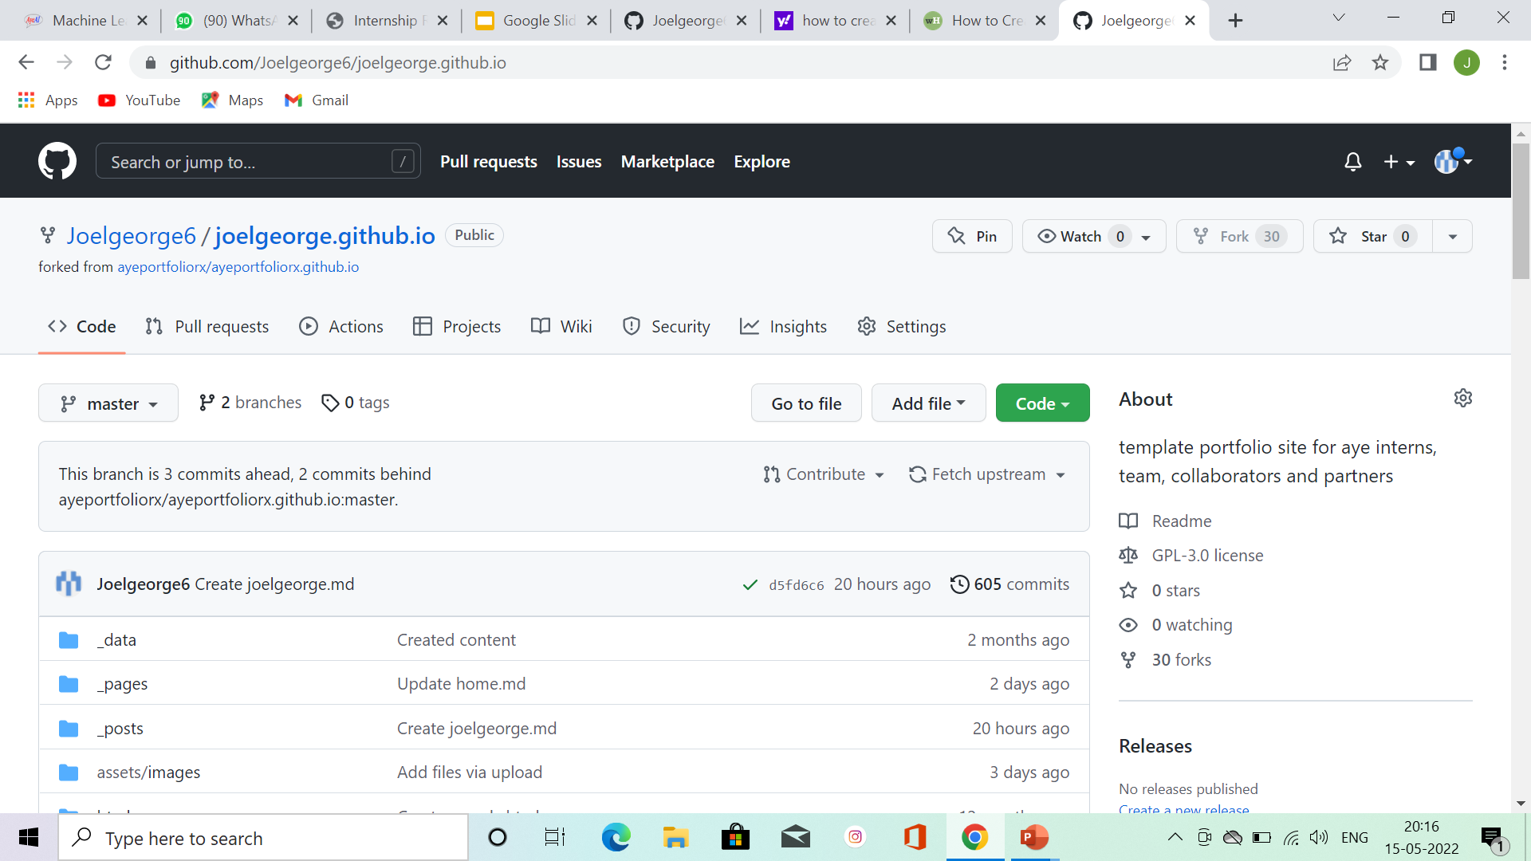
Github Basics
Forking
1.Go to the github forked id ,there will be a option on the right hand side called FORK
2.Click on that and then there will be the option of name the file there write name
And the nxt bar, write name.github.io
3.And create fork by clicking fork button below

Slide 7
Basics of a Colab Notebook
Colab Notebook :
.Collab notebooks are Jupiter notebooks that run in the cloud and are highly integrated with google drive
.There are two types of cells text and code

Slide 8
Pre-processing of Data
Data Cleanup :
The collected data after authorisation to use for academic and research purposes has been curated for data cleanup.
The following are the steps followed in data cleanup:
Data from excel format is converted to CSV
The CSV files are made suitable for Unix environment
Data Anonymization :
Any existing SPI in the data has been anonymised
Data has been normalised and combined into a single file for next steps

Slide 9
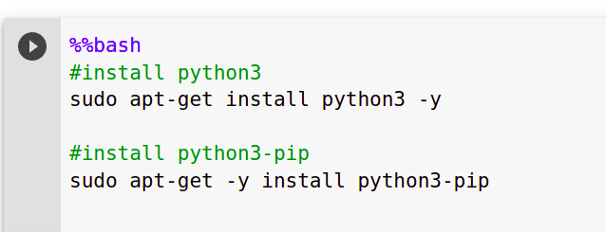
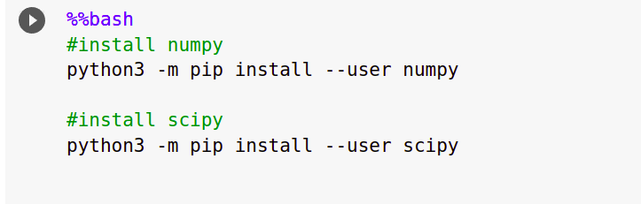
Preparation of UTI CDSS
Setting up the environment:
Python3 was installed along with the necessary dependencies including
Scipy
Numpy

Slide 10
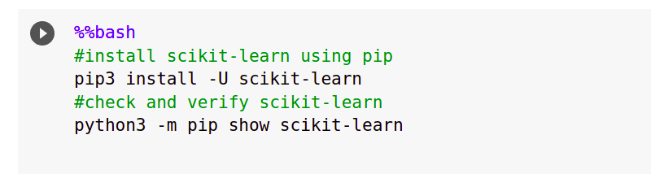
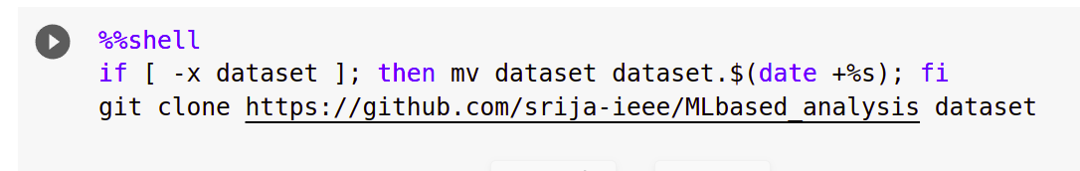
Preparation of UTI CDSS
Scikit-learn, a library for machine learning that helps in predictive data analysis has also been installed and setup
Cloning up the coded data files from Github into the Notebook

Slide 11
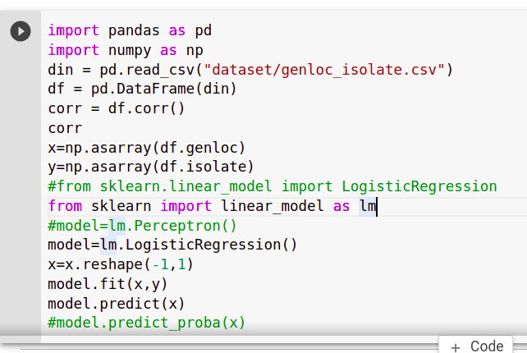
Preparation of UTI CDSS
Training and Testing the Data
The variables in the normalised data are coded to fit in the model and predict
Libraries like numpy, pandas have been used and the data have been fitted into DataFrame to find the correlation between the variables.

Slide 12
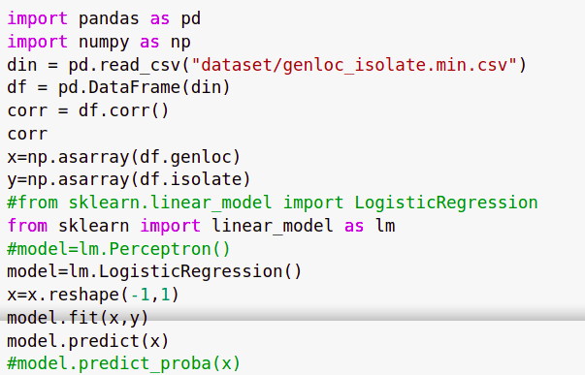
Preparation of UTI CDSS
Linear Regression model has been applied to predict the probability
The data is first trained and then tested to predict the probability
Then skewed data is eliminated and then the CDSS is made available to use with a sample data

Slide 13
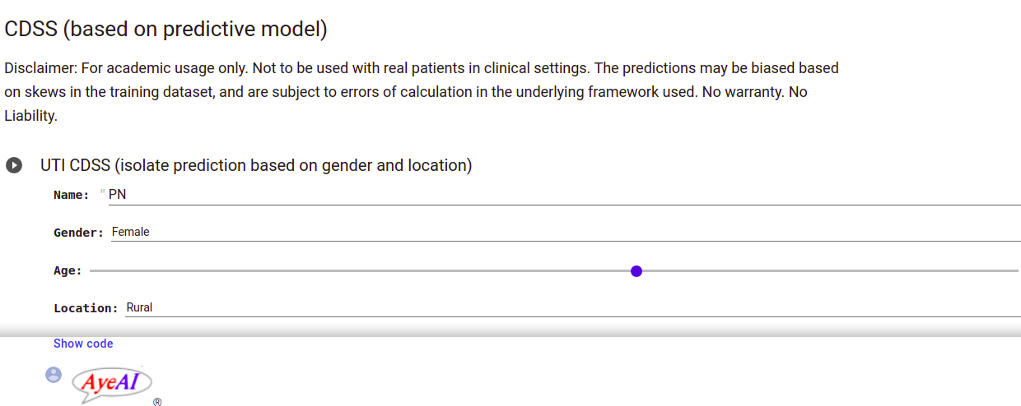
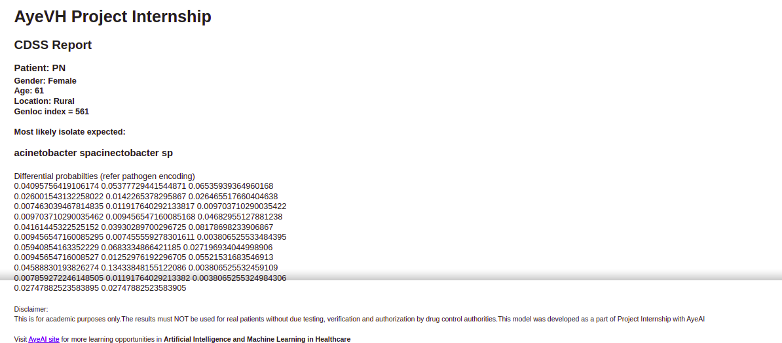
Preparation of UTI CDSS
Then finally CDSS UI is made to predict the likely organism that is causing UTI Based on age, gender and location.

Slide 14
Observations and limitations
Skewness in the data
The data collected is the skewed with data more than at least 30 % of E.coli and followed by klebsiella sp and e.coli esbl positive
Inadequate data collection
There were multiple incomplete entries in the data which don't have all the necessary variables.
The data on clinical signs and vitals are completely ignored, which are important aspects in the diagnosis of Infectious conditions.
Sample size is very less and does not form an representation of considerable region

Slide 15
Future perspectives & suggestions
Variables to be considered for Data Collection
Clinical Presentation of the patient
Vitals
Laboratory data
Suggestion
Increase the sample size
Getting more balanced data so that a single isolate does dominate
2. Ensuring completeness of data entries, so that better insights can be drawn per parameter

Slide 16
Disclaimers :
No warranties are made to the correctness of the information presented. User discretion is requested in the usage of the information contained herein. The information presented should not be used for any critical or life saving purposes. No claims are made to the fitness for any purpose, not even even the implied purpose of merchantability.
No claims are made to the currency of the information presented herein. The audience is advised to refer to standard sources for more current information.
The authors are not responsible for damages or losses incurred directly or indirectly as a consequence of accessing, applying or otherwise using this information. This information is shared only for scientific proliferation and towards generating productive dialogue
The audience are advised not to use the information provided in medical practice or other critical scenarios without appropriate certification / license or without the supervision of a registered medical practitioner.
The dissemination of this information does not constitute medical advice and may not be used as such.
This document does not form a product offering or contract of any sort.
Disputes are subject to the jurisdiction of courts in Hyderabad, Telangana, India only

Slide 17
Copyright © 2022 AyeAI Consulting
** Content are subject to terms and conditions, including disclaimers provided
This document is subject to the provisions of The Copyright Act 1957 (as amended by the Copyright Amendment Act 2012) of the Republic of India (Bharat), the provisions of the WIPO (World Intellectual Property Organization), and relevant conventions and charters. No part of this publication may be reproduced without the explicit written (non-electronic) permission of the copyright holders and the authors.
It is sold, or distributed packaged with other products, under the explicit conditions of NO WARRANTY and ZERO LIABILITY (limited to a maximum of INR 1/- one Indian rupee only). This document does not form a contract, neither a service or product commitment.
While we have exercised due diligence in presenting material that is accurate to the best of our knowledge as of the time fo being sent to press, or for online publication, there is no claim to the correctness of fitment to any purpose and the readers are advised, and cautioned to apply appropriate professional judgement in using the content presented. Alternate sources of information must be consulted to establish the correctness of material presented. If professional services are sought then the readers may contact the appropriate professional organization of their country of residence.
AyeAI and its affiliates reserve all rights, including publication, broadcast, archival, cinematic, artistic, as well as the right to make any modifications at the will of the managing partners in majority at AyeAI Consulting, including modifications to features, descriptions, specifications or otherwise make any changes desired, which may render the information in this document devoid of utility or information. No liability shall be brought upon AyeAI, its affiliates, or the authors in this regard, and no claims shall be admissible in any jurisdiction.
Any names of individuals, or bodies corporate (such as persons, companies, or societies) are meant to be fictitious unless claimed otherwise and any correlation to any person, living or dead, or any organization is only coincidental. The authors and AyeAI claim creative freedom of expression in this regard and for matters of fact presented, the rights of fair reporting are claimed.
This document is intended for distribution in India only and may only be accessed online through servers hosted in India or accessible through Indian electronic portals. All exports of this document must be duly authorized in writing by the managing partners of AyeAI.
The technology mentioned in this document may enable the readers to carry out experiments or activities in contravention of local laws, and AyeAI, its affiliates, and the authors strongly advise the readers to acquaint themselves fo the prevailing laws, rules and regulations. Any violations shall be the sole responsibility of the readers and the readers assume responsibility for all results, including results that may cause damage to people or property, including the loss of life, and thereby the reader expressly consents to waive AyeAI, and the authors from the consequences direct or indirect and the reader alone shall bear the cost, fines or other impunities including incarceration as may result. This document is shared in good faith towards greater and equitable dissemination of knowledge, but that is in no way an invitation to break laws, customs or hurt any sentiment. The reader must realize that with increased knowledge comes increased power, and with increased power comes the power to choose. The reader must always choose the path of legal, moral and ethical correctness. Once again, AyeAI Consulting reiterates that there is no warranty and zero liability, and this does not form a contract in any manner except for the claims to intellectual property and disclaimers presented.
NO PART OF THIS PUBLICATION MAY BE USED AS A BASIS OF ANY ACTIVITY OR IN CREATING ANY ARTIFACT MEANT TO BE USED IN CRITICAL OR LIFE SAVING PRODUCTS, WITHOUT THE ACTIVE GUIDANCE OF A LEGALLY QUALIFIED PROFESSIONAL.
This document must not be printed without permission of the managing partners of AyeAI Consulting and violators stand liable to prosecution. Even when printed with due permission and authorisation, the document must be printed only of acid free recycled paper.
All trademarks and copyrights are acknowledged.
All conflicts are subject to the jurisdiction of courts in Hyderabad, Telangana, India only.
Publisher: AyeAI Consulting
Series Dr Srija Katta: Abhishek Choudhary, Dr Srija Katta
Series Managing Editor: Abhishek Choudhary
Content Designer: Dr Srija Katta
Pre-press and composition: Same as Dr Srija Katta
Graphic Art: Same as Dr Srija Katta
Date of first publication: 16-December-2019
Cataloging Data : Not generated
ISBN / ISSN: To be assigned
Written in the Republic of India भारत गणराज्य में रचा गया

